Slide 1
Execution Approach
Preparatory Phase Duration:2 weeks
Objectives
Execution Phase (Proof of Concept Development)
Duration: 9–10 weeks
Future Phases (As per defined Roadmap)
Duration: Planned post-MVP — Timeline TBD
Assess current data maturity, focusing on the availability and structure of digitized past project FDS documents (PDF, Word, Excel), Raw AutoCAD files, scanned drawings (P&IDs, system architectures), and other inputs.
Evaluate AI readiness in terms of:
Document format consistency and quality
Text extractability (OCR needs, if applicable)
Metadata and tagging practices
Recommend preprocessing, structuring, or annotation needs for downstream AI tasks
Outcomes
Readiness Assessment Report
Data Inventory Matrix (Document Types, Formats, Quality)
AI Feasibility and Risk Analysis
Requirements for POC Phase, including access to the identified data and Emerson's subject matter experts.
On demand workshops/Assessments to be done in Emerson’s office location as needed
Identification of 1 focused Use Case for POC (e.g., Condensate Metering)
Objectives:
Develop and validate an MVP for 1 focused problem statement (e.g., Generating the "Measurement Calculations" and "Flow Computer Configuration" sections for a Condensate Metering Package).
RAG and Prompt-engineering driven LLM to convert inputs (requirement docs, technical specs) into draft FDS
Build document pipelines for ingestion, parsing (including CAD metadata/text, if needed), and transformation
Implement human-in-the-loop feedback loop for iterative refinement
Conduct stakeholder demos and reviews
Assess quality of generated documentation against existing baselines
Deliverables
Functional PoC Demonstration with working examples
Accuracy and Performance Evaluation Report
Feedback Logs and Enhancement Recommendations
Objectives:
Extend use case coverage across multiple functional packages or domains
Incorporate additional data types (e.g., schematics, control narratives)
Integrate with existing ERP / MES systems
Expand model training with organizational vocabulary and historical specs
Deploy in enterprise setting with access control, audit, and versioning
Proposed Roadmap Milestones:
Use Case Expansion Plan
Enterprise Architecture Design for LLM-based Doc Automation
Tooling and Workflow Integration Plan
Data Governance and Feedback Incorporation Framework
Roadmap of implementation for complete pipeline
Evaluate the organization and content consistency within the existing FDS repository.
Identify potential challenges with non-text-based key inputs like P&IDs and system architecture diagrams.
Inventory of available technical documentation, business requirements, and FDS examples within the repository.

Slide 2

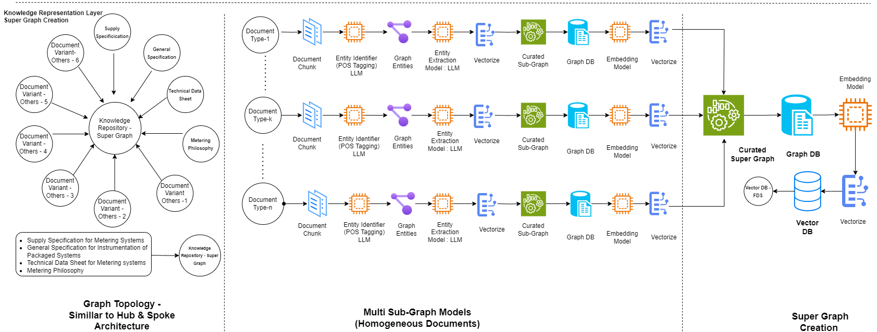
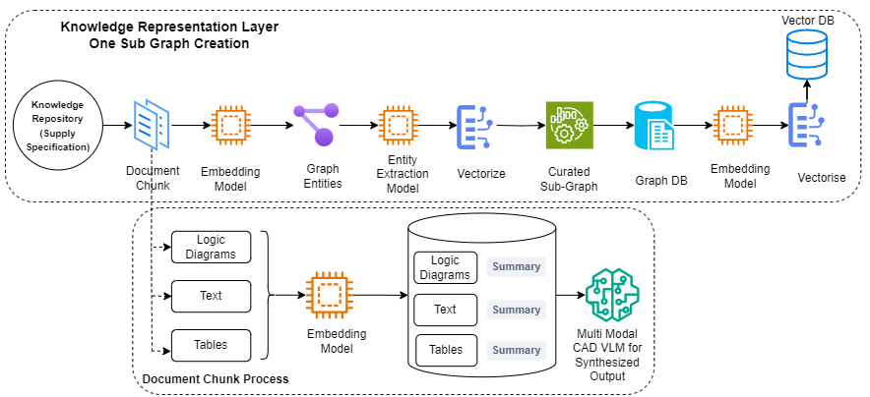
Conceptual Architecture Diagram : Knowledge Representation & Reasoning Layer (Documents)

Slide 3
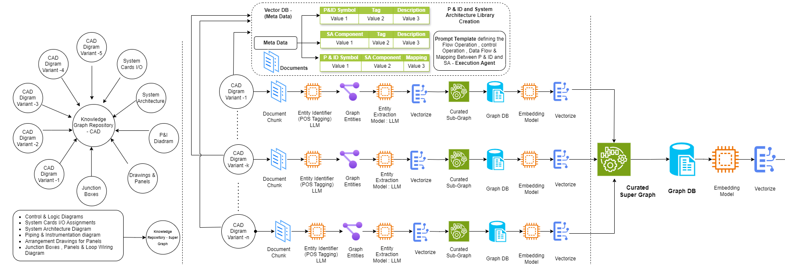
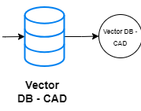

Conceptual Architecture Diagram : Knowledge Representation & Reasoning Layer (CAD Designs)

Slide 4
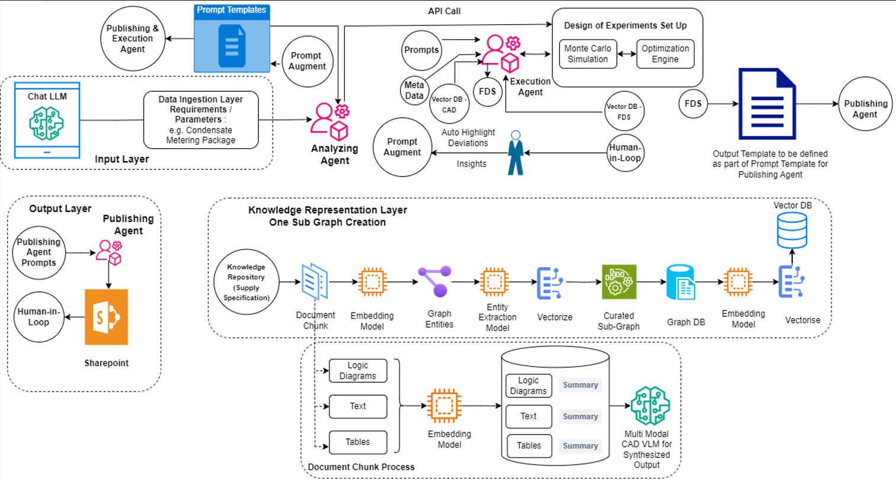
Conceptual Architecture Diagram – Presentation Layer (Interactive User Interface)

Slide 5
Indicative Requirements for Hardware, Software Data & Infrastructure
Category | Requirements | Purpose / Description
Hardware | Optional on-prem GPU-enabled servers Cloud GPU access (e.g., NVIDIA A100, V100, T4) | Dev environment, Model Inference, CAD parsing, Prompt Tuning
Software / Tools | LLM APIs: OpenAI GPT-4, Claude, Mistral, LLaMA 3 , LLaVA Prompt orchestration: Pydantic & Langchain, Llamaindex OCR (if needed): ABBYY, Tesseract | Core LLM access and orchestration; text extraction Evaluation in Assessment Phase would help us to narrow down to the correct set of LLM(s)
 | - Document Parsing: Adobe PDF SDK / PDF Miner , AutoCAD APIs | Extract text, metadata, and annotations from engineering documents
 | - Raw CAD Files of P&ID and SA Embedding – LLaVA NeXT | Interpretation of CAD Files into Entity-Relationship Format
 | -Multi-Vector Retriever: Langchain , LlamaIndex + ColBERT / Hybrid RAG | RAG on structured (tables), unstructured (text), images, equations
 | Special Embedding Models: • Google’s PaLM-e (Vision+Language) • OpenAI’s CLIP for Symbol+Text • Hugging Face Transformers for domain tuning | Generate and understand P&ID symbols, architecture diagrams, and cross-linking with descriptions
Data | - Business Requirements, Legacy FDS, AutoCAD Raw Files , Scanned PDFs, Control System Instrumentation Narratives | Raw input for ingestion and transformation
 | - Symbol Libraries: P&ID, ISA S5.1, ISA 5.3 standards, Electrical & System symbols | For symbol recognition and semantic mapping
 | - Domain Glossary, Engineering Equations, Instrument Tags | Enables technical accuracy in generated outputs
 | - Metadata Tags: Project ID, Author, Revision, System Type, Signal Path | For indexing, traceability, and semantic linking
Infrastructure (Needs to be Evaluate during Preparatory Phase) | - Cloud Infra: Azure, AWS, or GCP with secure container orchestration (Kubernetes/Docker) | Scalable and secure backend deployment
 | - Vector Databases: FAISS/ Pinecone/Weaviate/Qdrant | Store multi-modal embeddings for retrieval during RAG
 | - RBAC & Audit Trails: Azure AD, SSO, logging tools | Enterprise-grade access control and compliance
 | - CI/CD + Monitoring: Azure DevOps, GitHub Actions | Continuous delivery and operational visibility

Slide 6
Functional Feature | Description | Tool Stack / Enablers
Multi-Document Understanding | Ingest and parse heterogeneous documents (PDF, Word, Excel) like Metering Philosophy, Supply Specs, TDS | LangChain Document Loaders, spaCy
FDS Section Auto-Generation | Automatically generate draft content for structured FDS sections (e.g., Scope, Calibration, Instrumentation) | GPT-4o, LangChain or LlamaIndex, Prompt Layer, Pinecone/FAISS
Source Referencing & Justification | Embed traceable references in generated text linking back to source paragraphs or figures | Retrieval-Augmented Generation (RAG), Neo4j LangChain Memory
Terminology & Unit Harmonization | Standardize tags, units, component names, and document vocabulary across references | Talend MDM, Custom Glossary APIs, Metadata Catalogs (e.g., Collibra), spaCy pipelines
Domain-Aware Content Generation | Ensure generated FDS content aligns with industry standards like API MPMS, ISO 5167 | Prompt Engineering + Ontology/Knowledge Base, Vector Embeddings, LangChain Tools
Conflict & Gap Detection | Detect contradictions or missing values across specs, highlight them for SME validation | Rule-based comparison engine, Pandas + GPT validation, Document Diff Tools
FDS Document Assembly | Compile sections into a professional FDS document (DOCX, PDF, XML), with tables and headers | docx-template, Pandoc
Lineage & Change Traceability | Maintain audit trail from each FDS section to original spec version and paragraph | Neo4j
Engineer Review & Feedback Loop | Provide editable UI for SMEs to review and refine generated content with contextual references | Streamlit, LangChain, React UI with trace memory
Export in Multiple Formats | Export finalized document in various formats for documentation or integration with EDMS/PLM | Python Export Libraries (docx, pdfkit), JSON/XML schema mapping, REST API Endpoints

